Slide 1





Rural Red Deer Restorative Justice Program
Facilitator Orientation
Module 2- Interviewing Skills
Notes:
The Purpose/Goal of Module 2 is to help new facilitators attain the knowledge and skill to effectively conduct pre-conference restorative justice interviews….so that… pertinent information to support a successful case conference is both collected and shared.
here are two components to this module:
Module 2a- knowledge acquisition
Module 2b- skill acquisition
Objectives
At the completion of module 2a (knowledge), you will be able to :
Identify strategies that can be used to create a climate of trust and willingness to share with youth and with adults
Identify active listening strategies that support effective information transfer.
Identify various responses that will encourage the participant to share information and feelings and support problem resolution.
Understand the components of reflective listening

Slide 2
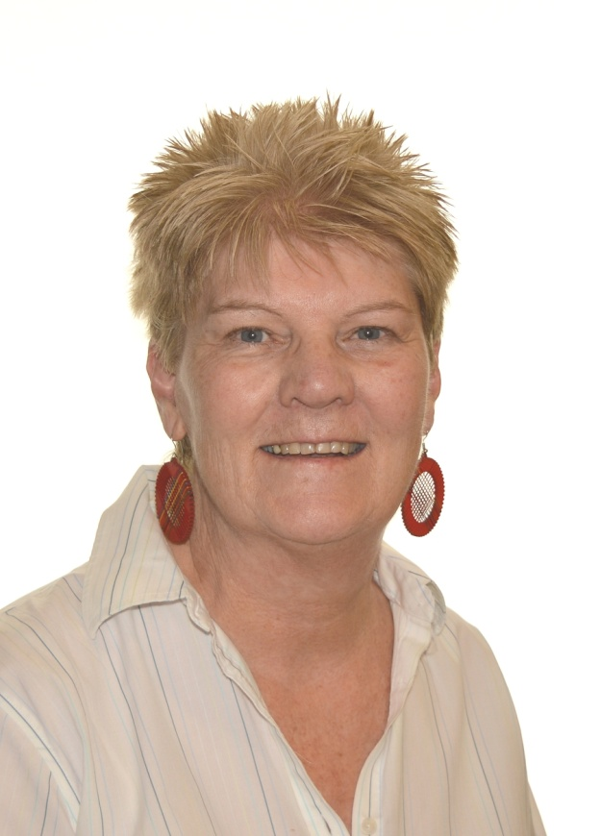
Agnes Struik
RRDRJ Program Educator
Notes:
Hello, My name is Agnes Struik and I will be leading Module II on Facilitation.
This module is divided into two parts. A,
which is about knowledge and skills needed in facilitating and B,
which will require practicing the skills learned in part A.
Prior to commencing with this module you will need to make sure you have the materials
which were sent to you in preparation for completing the module.

Slide 3

Preparation
Materials you will need for this module:
Handout – Characteristics of a good facilitator
Handout - Reflective Responses
Handout – Five Important Aspects of Active Listening
The Code of Ethics – refer to RJ website

Slide 4

Key Role of RJ Facilitator
To make the process easier for everyone involved!
Notes:
Module II covers the training pertaining to facilitation.
If you were to look up the meaning of facilitator
you would find that a facilitator is a person or thing that makes an action or process easier.
Your task as a Restorative Justice Facilitator has to do with making the process easier
for those who have been harmed or
for those who have done the harm.

Slide 5
The good facilitator helps everyone communicate but especially those who caused harm to more easily:
What they have done,
How they felt then and now
How they hope to take responsibility
How they may make amends for what has occurred.
Notes:
When you work with the youth in the RJ program
your job is to make easier their ability to communicate (1) what they have done,
(2) how they felt and feel now, and
(3)how they hope to make amends for what has occurred.
Whoa! That sounds like a big task doesn’t it?
It is and it takes a person with certain characteristics to do this kind of work,
many of which you already have or you wouldn’t have been inclined to apply for this work.

Slide 6
A Good Facilitator:
Respects and appreciates people
Is compassionate
Is Self aware
Understands behavior may be expression of inner feelings
Is ready for anything and able to change at a moment’s notice
Notes:
One of these characteristics is to respect and appreciate people. This is important because you will be coming across all sorts of people, wealthy poor, educated uneducated, people of different races, people of different religions, different sexual orientations, old and young people. You’ll need to be able to respect that we are all born free and equal and have a right to belong.
#2 A sense of compassion – If you didn’t have a sense of compassion it would be difficult to do this work.
However having a sense of compassion and expressing it when appropriate are two different things.
Some exercises in this seminar will clarify this.
#3 To be self aware –To me, being self aware is one of the most crucial attributes of a facilitator.
If you don’t know yourself,
your strengths and weaknesses, your blind spots, your vulnerabilities
you will not be able to accomplish what is needed for the interview.
This doesn’t mean you need to be perfect.
Heavens no! Most of us can’t stand being around the “perfect” person.
We just need to be aware of our sensitivities or when our buttons are being pushed.
#4 A good facilitator watches body language
and can detect the youth that is hurting on the inside
but presents a tough exterior
or the perky cheerful teen who is actually nervous and anxious.
#5 To be ready for change at a moments notice- is key
because you may be expecting to have someone taking full responsibility
because they signed the restorative agreement,
and then find yourself confronted with a defensive parent
or you may find the information you received from the police report
doesn’t jive with the story you are getting from the youth.

Slide 7
A Good Facilitator:
Is present in the moment
Is observant
listens, shares and finds ways to help individuals express themselves
Is prepared to repeat over and over again
Models honest and open behavior
Is not judgmental
Acknowledges and validates individual's experience
Notes:
#6 You will be able to be ready for sudden change
if you learn to be present in the moment.
By that I mean be aware of what's happening right now.
Bring your focus to the people and situation in front of you..
#7 Be observant - Notice little things;
relationships between people in the room,
how people seat themselves; close far apart,
eye contact,
are they figidity etc.
#8 Listen and share - Speaking is not always a person’s first way of expressing themselves.
Be prepared to offer your interviewees alternative ways of expression.
Would it be easier if you were to show me how this occurred?
How about if you drew a diagram?
Before we meet again, would you like to write it out first?
#9. Repeat - When people are frightened and especially if they are traumatized
their frontal cortex, the thinking part of the brain shuts down and it is very difficult to absorb cognitive information
so it is important to deliver information slowly
step by step and if necessary over and over.
#10 If you can show honest and open behaviour and admit
, “hey I been where you are” or
“its hard to have to own up to what you’ve done in front of people who care about you.”
it is easier for youth to make a connection with someone who has been there.
#12. Judgmental -It is so easy to make assumptions in this work.
You have a youth during the interview who hardly says anything,
seems disengaged
and then at the conference shows that s/he has thought deeply about the situation
and taken responsibility and made steps to move forward
or you think “oh this case will not be problematic”
and it turns out to have all sorts of twists and turns.
#13. Validation -An interviewee may say,
“ There is not one single person at that school that likes me
” Rather than trying to convince him/her that there must be a least one person that likes him or her
go with the underlying feeling being expressed.
This person is so isolated and lonely.
It sounds like s/he doesn’t have any friends at school.
So start slow and validate the feeling.
"That must be so horrible for you…..It sounds like you are all alone… and so on.

Slide 8
A good facilitator:
Provides for a safe space
Reflects what’s being said on a meta level
Is able to say: “I don’t know. Let me think about it or check it out with my team and get back to you”
Is able t say: “I’m sorry, I made a mistake”
Notes:
#13. Safe space – This is a phrase that comes from early childhood work
and has to do with parental provision of needs of protection, care and nurturing.
We are speaking here not only of physical needs but of a deep sense of well-being.
The facilitator tries to provide as safe a place as s/he can in both a physical and emotional sense.
#14. Reflect what is being said on a meta level. When I speak of reflecting what is being said at a meta level
I mean Go for what is not being said but intimated on a feeling level.
“I hate my dad he’s ….is not really what its about.
Hate is a rather global expression.
Break it down. ” Sounds like your really frustrated and angry with your dad?”
#15. It is important that youth know that you don’t have all the answers
especially at an age when they are often plagued with perfectionism and a need to do it right.
#16 It is so important for youth to know that adults
are willing to own up and take responsibility when they make a mistake.
This is the RJ facilitator modeling at its best.

Slide 9
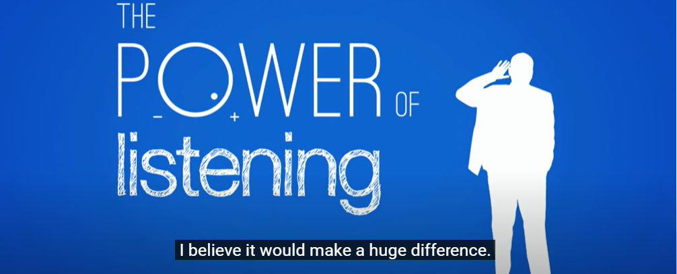
The Power of Listening
(1349) The power of listening | William Ury | TEDxSanDiego - YouTube
Notes:
By this time you have likely realized that listening to the youth you are working with
is a very important aspect of this work.
It can make or break your relationship with youth.
The next section will focus on listening skills and we will begin with a Ted Talk.
To access the video, click anywhere on the slide and it will take you to the YouTube,

Slide 10
Being Heard and Seen
Being attentive is vitally important.
You might have a youth whom you have been told has taken responsibility for the harm he has done but now in the interview is saying “ but it wasn’t my fault”
The temptation is to let our mind run ahead of itself and start thinking of what to say in response rather than to continue to listen to why he thinks it is not his fault.
Notes:
As William Ury explained being heard and seen is vitally important.
It is easy to become unfocused and think about how to present ourselves
rather than paying attention to what is in front of us. T
hen we can fail to obtain the complete picture of what is going on.

Slide 11
Being Seen and Heard
Someone might be totally in sync with the restorative process. Everything is going well so our mind might be jumping ahead thinking what the youth might do to make amends – community service? work at a pet store? or maybe at a ranch?
We aren’t doing them the justice of really seeing and hearing them. Instead, they have become one of many.
Notes:
Another example of how easily our mind can wander.

Slide 12
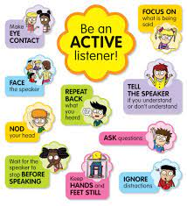
Active Listening
Active listening
Pay attention to the conversation and to the speaker.
Be observant and ask sensitive questions to obtain information that is not being explicitly disclosed.
Notes:
Active Listening requires the facilitator to be committed
to becoming engaged with the youth who is speaking.
That requires the facilitator to be in the moment,
paying attention to not only what is being said
but also to the youth
and then to provide feedback based on that information.

Slide 13
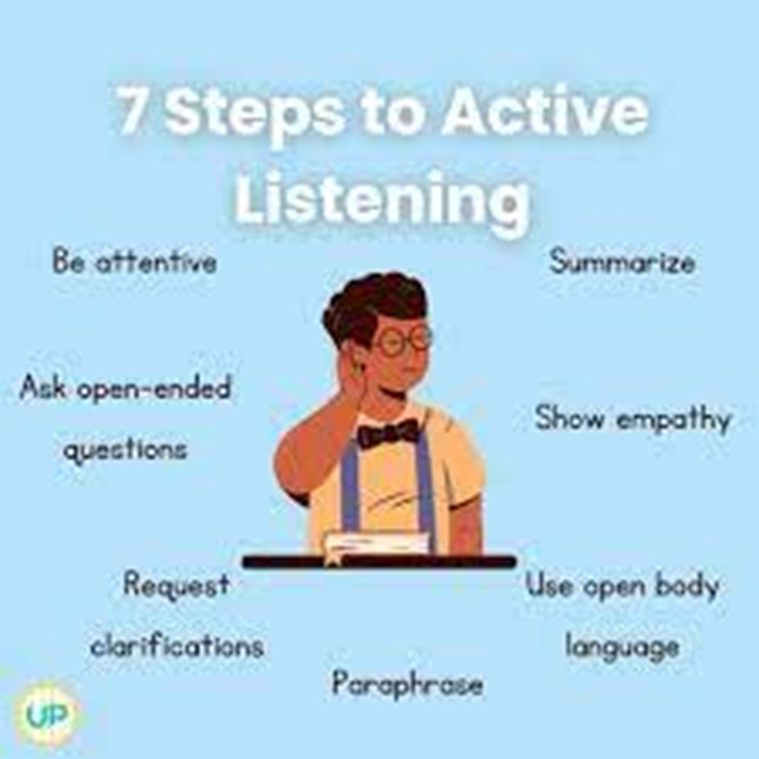
Active Listening
You can do this by:
Eye contact
Smiling
Agreeing with a head movement
Inclined posture “you have my attention”
Notes:
Active listening is a process where you become informed
not only about what the youth says but also what is not said.
Many of these nonverbal signals are automatic.
Sometimes when we are nervous or worried
we find it hard to stay in the present .
Our bodies may go still or give signals that are inconsistent with what we are saying.

Slide 14
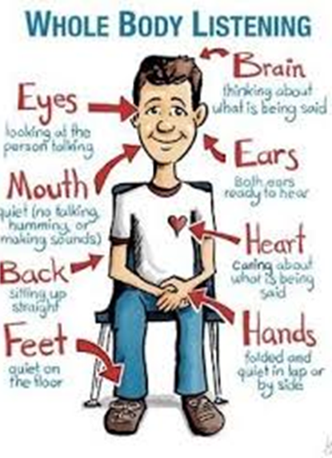
Active Listening
Avoid getting distracted
Focus on the Speaker
Don’t interrupt with your own perceptions
Use attentive body language
Paraphrase
Notes:
There are ways to stay in the moment and enhance active listening
#1. Avoid getting distracted – That means get rid of your devices etc. Noise and people interruptions are under your control
but thought distractions are not as easily controlled. T
Take time to prepare for your interview
,get centered so your thoughts are focused on your interview
and not on the meeting you just left or your grocery shopping tomorrow.
#2. Focus on the Youth – We need to focus on the youth
giving them your full attention.
While I say that, be aware that some youth
are not used to a lot of attention and become very self conscious
so be aware of comfort level.
#3. Don’t interrupt with your own perceptions – We’ve talked about this before too but from another perspective
when we spoke of allowing youth to have their own thoughts and feelings.
If a youth says, “Well, we were drinking and then some of us…”interrupting with your perception of
“you’re a little young to be drinking aren’t you?” will shut the conversation down.
There will be another time to deal with underage drinking.
The interview is not about you.
It is about the youth and their perceptions.
#4. Use attentive Body Language – We talked about this too.
#5. Paraphrase – Summarizing what has been said lets the youth know that you’ve understood what has been said.
It also feeds back to the youth a concise image of what has happened.
Often youth tell a rambling story
where the pieces are somewhat convoluted and not always in proper sequence s
so when you can say, "So what I hear you saying is You left your home after school and met up with……
The youth know then
that you cared enough to listen to them.

Slide 15


Active Listening
Let’s try this out:
A young girl speaks in a low voice and makes little eye contact as she tells you how she has been bullied all year by the kids at school.
How will you respond? What will you say? What is your nonverbal body language? (Possible Response on next slide)
Notes:
Let's try this out

Slide 16

Active Listening
You lean forward and say in a quiet voice, “So what you’re saying is that you’ve not been treated very well at school this past year?”
or
“That’s awful, it sounds like you are pretty much alone.”
Notes:
How did that go? Bottom line the main component of facilitation is staying connected to the youth you are working with.

Slide 17
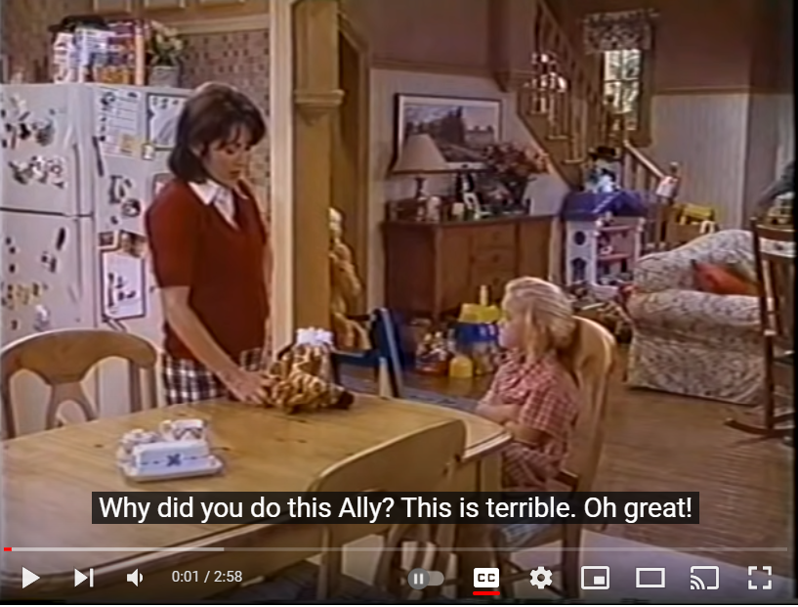
Everyone Loves Raymond- active listening
Notes:
Here is a humorous clip from Everybody Loves Raymond
where he uses what he learned at his Active Listening class.
Just click on the slide to connect you with the video

Slide 18

Reflective Listening
To be a good reflective listener, you need to set aside your own wants and needs briefly and work to make sure the speaker gets your full attention and empathy and knows that you understand what is being said.
Notes:
Good facilitation is about connecting, about creating a relationship.
Reflective listening goes a step further than active listening.
It helps the other to clarify and understand their thinking.
Reflective listening helps people clarify what’s underneath their thoughts and emotions
and come up with solutions of their own.
Reflective listening helps people know you not only understand them
but also can help them clarify their thinking.
This is important because it empowers to come up with solutions of their own
rather than make them dependent on the insights of others.
You take what is said, put it in your own words and give it back with a ? at the end.
You really wish you could live with your dad in Nova Scotia?
Pretty simple huh?
But you need to not only let them Know you understand,
you need to Show them you understand.
It doesn’t do any good if you understand but they don’t know it.
Hearing it back can be helpful in affirming they’ve been heard.
Or saying, “let me get this right, just so I know we are on the same page…

Slide 19
Five Aspects of Reflective Listening
Encouragement
Questioning
Reflecting
Paraphrasing
Empathy and Speaker Solution
Notes:
These five aspects sound very much like those we talked about with Active listening.
Lets take them a bit further and think about them in terms of putting away your agenda
and giving full attention in order to help clarify thinking and emotions
Encouragement – This often is helpful at the beginning of the interview when everyone is nervous.
First validate the courage it took to choose the RJ route,
then say something about how we can work together.
Then even though the story may sound muddled just let the youth talk without interruption
until s/he feels settled and can talk more freely.
Questioning – Ask clarifying questions to make sure you understand what the youth is saying.
For example if the youth said, “That coach makes me feel so stupid!”
you might say “it sounds like/you look like you are pretty upset.
Can you tell me what happened?”
Notice, pay attention to the feelings first and empathize,
then ask a question. You are more likely to get an answer to the question
if the youth senses that you get how s/he feels.
Reflecting – Listen for the underlying emotion.
For example if the youth says, “My neighbor is such a jerk!”
you might say with emphasis “you sound really angry.” or “You sound frustrated.”
Paraphrasing - Paraphrasing what the youth is saying in question form.
For example if the youth says “My teacher never listens to me”
you might say “You don’t think your teacher listens very well and you want to tell her something?”
Here you are paraphrasing but also listening for what’s underneath.
The youth says the teacher doesn’t listen
but what he is really saying is I don’t feel heard.
Empathy and Speaker Solution – Approach the conversation with the belief
that the youth has the ability to solve the problem for themselves.
Resist the temptation to offer advice or give opinions about what the youth is saying.
It is so tempting to rescue a person in pain or give advice to a youth in trouble.
That’s partly why we are in this work right?
We care about people.
But the most help we can give youth
is to empower them to come up with their own solutions.
We can guide them,
but they need to come up with the answers.
Then they will be proud of themselves!

Slide 20
Examples of Reflective Listening
“My mom could be my support person.”
“How about your dad, do you want him there too?”
“No, my dad hardly ever comes to stuff like this.”
“You don’t think he might want to come to support you?”
“It’s not that he doesn’t want to support me - .”
“But you don’t think he’d want to be here?”
“It’s just- that- I think, he thinks- its partly his fault…”
Notes:
Let’s look at this example
Notice how the facilitator feeds back what the youth says
but with an added bit of wondering or need of clarification.
And notice how the facilitator clarifies the ambivalent feelings.
Only then can they be addressed.

Slide 21
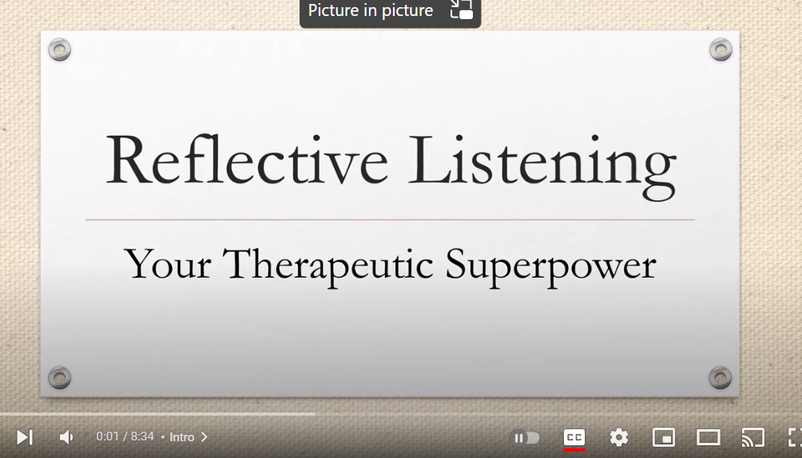
Notes:
Sometimes Reflective Listening is called Empathic Listening
because it puts such a strong emphasis on empathy
or standing in the shoes of the other person
to get a sense of what it would be like to be them.
This YouTube gives a thorough summary of reflective listening.
As before click anywhere on the slide...

Slide 22

The Art of the Interview
Reflect Feelings
Repeat
Normalize
Explore
Convey Understanding
Release the Person
Empower
Set Limits
Praise
Facilitate Insight
Give permission
Model
Reflect
Reassure
Encourage
Question behavior
Ask open-ended questions
Notes:
Reflective listening is not easy to do.
As William Ury reminds us , our minds are so preoccupied with other things
we often forget to truly listen to others, often those closest to us.
Another reason is ,unfortunately many of us
have not grown up with reflective listening
as part of our narrative.
The next part of this module will provide you with examples of some phrases
you can use while facilitating in your interviews.
At first it may seem a little awkward
but very soon you will find yourself responding in a very natural way.

Slide 23

Facilitative Responses
Reflect feelings
“You really sound angry that the rest of your friends refused to own up to what you all did.”
Repeat
“You may not remember that I told you this but it’s not at all surprising that you’d feel embarrassed to have that put on Facebook”
Notes:
#1 You will notice how often I speak of reflecting feelings. This is not a skill that comes easily
but when used
it can have powerful results.
It also mitigates the need to give advice or fix things.
#2 Repeat - Remember what I mentioned before about fear and trauma,
repeat but do so with patience and understanding.
For example you may have to go over the sequence of the events
in an offence a number of times.

Slide 24
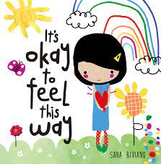
Facilitative Responses
Normalize
“It’s quite normal to feel upset about what your brother experienced. I would too if I were in your place.”
Explore
“Tell me more about your mixed- up feelings”
Notes:
#3. Normalize – let your interviewee feel
that s/he is not alone
and that others often feel the same way.
#4. Explore – Often youth say they don’t remember
or they don’t know.
Rather than say “Oh come on, you must remember something.”
take them at face value and say,”
Okay, let’s back track a bit .
You remember when your friend called you and said You want to hang out?
Let’s start there.

Slide 25
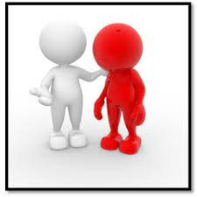
Facilitative Responses
Convey Understanding
“It sounds like you’re angry but also kind of relieved to get a chance to talk about this.”
Release the person
” In this interview you can talk and express your feelings freely so we can figure out things before we get to the conference.”
Notes:
#5. Convey Understanding – If you can reflect back to youth
what s/he seems to be feeling
there is a feeling of being understood
especially if s/he seems confused about feeling two emotions simultaneously.
They may want to quit doing drugs but at the same time they' may be scared to do so.
#6. Release the Youth – Let the youth know that they can express themselves pretty freely and let out their anger or frustration without being judged, that often if we deal with the strong feelings we can see more clearly what we are up against.

Slide 26
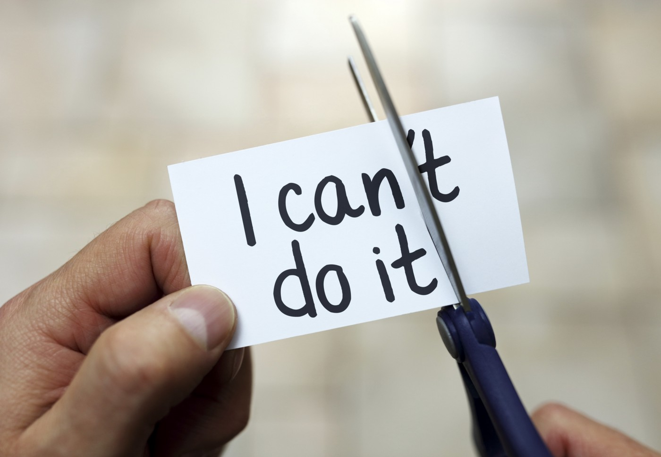
Facilitative Responses
Empower
“ In the RJ processes we want to give you the opportunity to decide.”
Set Limits
“I know right now you are angry and you feel everyone is an asshole, but how do you think it will go over at the conference if you start calling people who are trying to help you assholes?”
Notes:
#7. Empower – Youth at this stage of development often feel powerless
so we want to give them opportunities
for good decision making; f
or saying yes or no to themselves and others.
#8. Set Limits – Allow youth to express themselves
but also indicate that there are times and places
where expressing themselves in this way
will not endear them to other people
or enhance their presentation of their story.

Slide 27

Facilitative Responses
Praise
“Jessica, it takes courage to own up to the fact that it was you who broke into the convenience store.”
Facilitate Insight
“What you thought was a small prank ended up with someone being hurt.”
Notes:
#9. Praise – Everyone likes to know that someone appreciates them.
Even though they may say “It was nothing” or “I didn’t have much choice,”
they need to know even coming to the interview
was an act of courage.
#10. Facilitate Insight – Sometimes youth see their actions as separate little incidents
and need help realizing how one thing inadvertently leads to another.
They need to know how every little action has consequences
whether beneficial or destructive.

Slide 28

Facilitative Responses
Permission
Giving permission – “You said you are having an awful day. I get that, I have them too. Let’s see what we can do while taking into consideration your awful day.”
Model
Modeling –”It took me a long time to realize what other people thought about me wasn’t as important as what I thought about myself.”
Notes:
#11. Giving Permission – Allow the youth to have their feelings,
whether grumpy, or angry or happy.
Too often they are told how to feel.
Sometimes you might have to say,
“I know you had a rotten day and that sucks,
but do you think you could put it to the side for awhile
so we could talk about what happened when you and Timothy Parks ended up in a fight.?”
#12. Modeling – In whatever way we present ourselves
we are showing youth a way to be in the world
so its important to be as real and authentic as we can.

Slide 29

Facilitative Responses
Reflect Observations
“I can see you’re a bit uncomfortable being here…”
Reassure
” I can’t promise you everything will work out just the way you want but most people have been quite satisfied with the outcome of the RJ process.”
Notes:
#13. Reflect Observations - Sometimes this means telling it like it is
so the youth know you are seeing them.
"Yes that was a stupid thing to do
and I know you're smarter than that."
#14 Reassuring - Letting the youth know that you are in control t
hat you are not superman.
But with their help
you will do for them
all that you humanly can.

Slide 30

Facilitative Responses
Encourage
“Remember part of who we are is not all of who we are”.
Question the behavior not the person
“Just because you did a foolish thing does not mean you are a careless and insensitive person.”
Notes:
#15. Encourage – When youth have offended
they often feel guilty or feel that they’ve deeply disappointed their parents
so to encourage them you might let them know
that they are made up of many parts
and yes they did something foolish
but there are many parts to them their parents still find lovable…
#16. Question the behaviour not the person – This is similar to the one above
. Because you did one foolish thing
does not mean you are no good.
What you do and who you are,
are two entirely different things.

Slide 31

Facilitative Responses
Open ended Questions:
“So how do you think you will deal with that?’’
“What do you think should be done about this situation?”
“You strike me as someone who has an interest in computers, is there a program for that?
Notes:
17. Open-ended Questions Open ended questions encourage youth to think and act for themselves.
However many youth are in the RJ process
because they've never been taught how to think or decide for themselves
so it is important how we phrase open-ended questions.
Sometimes its important to start with
“so how should “we” deal with that
so there’s a recognition that we’re in it together
Later when the youth has more confidence and skills you can say “what will you do now?”

Slide 32

RRDRJ
Code of Ethics
Self Determination
Impartiality
Conflict of Interest
Role Conflicts
Confidentiality
Competence
Integrity of Process
Co-facilitating
Respectful Inclusive Conduct
Transparency
Do No Harm
wwwrrdrestorativejustice.ca
Notes:
The RRDRJ Code of Ethics serves as a guide when you are faced with difficult situations
and are unsure of what to do during any phase of the RJ process.
Reflect upon the underlying intent of each of these principles.
What does self determination mean to you?
How would you use Impartiality during an interview process?
How would you know if you were involved in a situation where you suspect there is a conflict of interest or a role conflict?
What’s the difference.
What are the actions that you must take to ensure confidentiality of a case?
How do maintain your competence
so that when you assume the role of facilitator you have adequately prepared yourself to do so?
What does integrity of process mean?
When you co-facilitate a case- what is your obligation to one another?
What is an example of respectful inclusive conduct?
Transparency?
How can you ensure that you do no harm?
Complete the mix and match ethics exercise on the website.
Read each scenario carefully,
review the list of ethic principles and select the principles that you think apply
(there are more than one for each scenario).
The purpose of this exercise is not about getting a perfect score but to familiarize you with the Code of Ethics.

Slide 33
Summing it up
Successful interviewing is an art. It is a combination of listening and responding with empathy and thoughtful intent.
A successful RJ facilitator uses ethical principles to guide them in their interviewing.
Notes:
Thank you for participating in module 2A –
the next step is to enroll in Module 2B where you will have an opportunity to put the information you learned today into practice!

